Slide 1
Spectral Salience
Team Members - Nathan Cox, Nahom Getaneh, James Hooper, Luis Ramos, Nick Taormino, Brad Wilfong
Team Leader - Dr. Lin Deng
Technical Director: Will Price

Slide 2
Introduction
Problem statement
The overall issues of this project is to detect and capture RF wavelengths and be able to train a system to recognize patterns and classify and label the variation of input signals. Ideally we would use a RNN machine using a Tensorflow method to achieve this goal.
Purpose statement
Overall goal is to create a RNN machine learning system that takes in RF waves as input, which detects and classifies them within the spectrum of RF waveforms. This system should then be able to produce an output of a labeled RF snapshot.

Slide 3
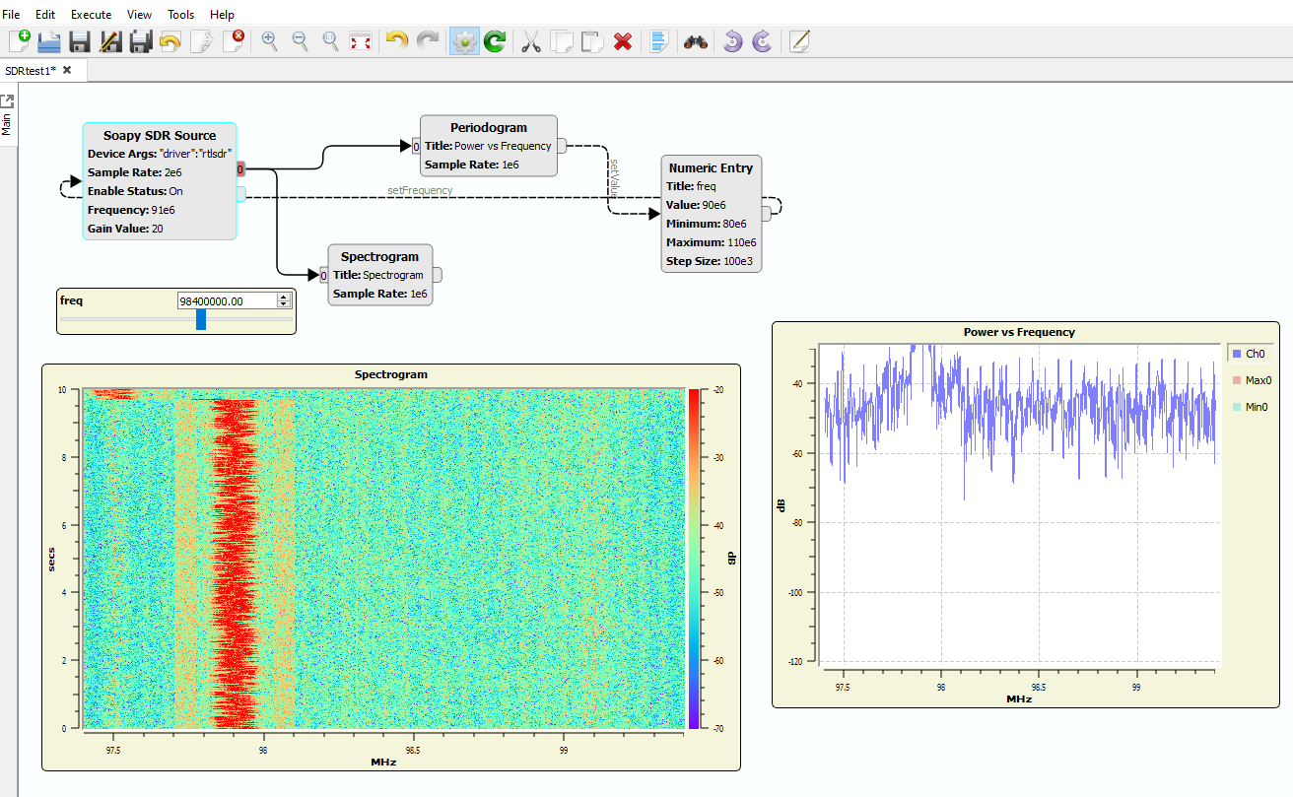
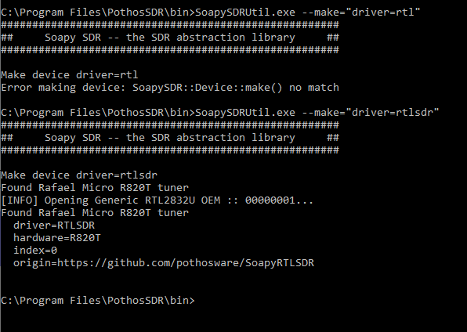
Progress
The software and hardware set up to gather data was the first step taken.
We then began using the RTL and SDR hardware using Pothos Flow and GNUradio under the Ubuntu Linux distribution.
Further testing could not be done due to campus closure.
Develop and finish RNN model

Slide 4
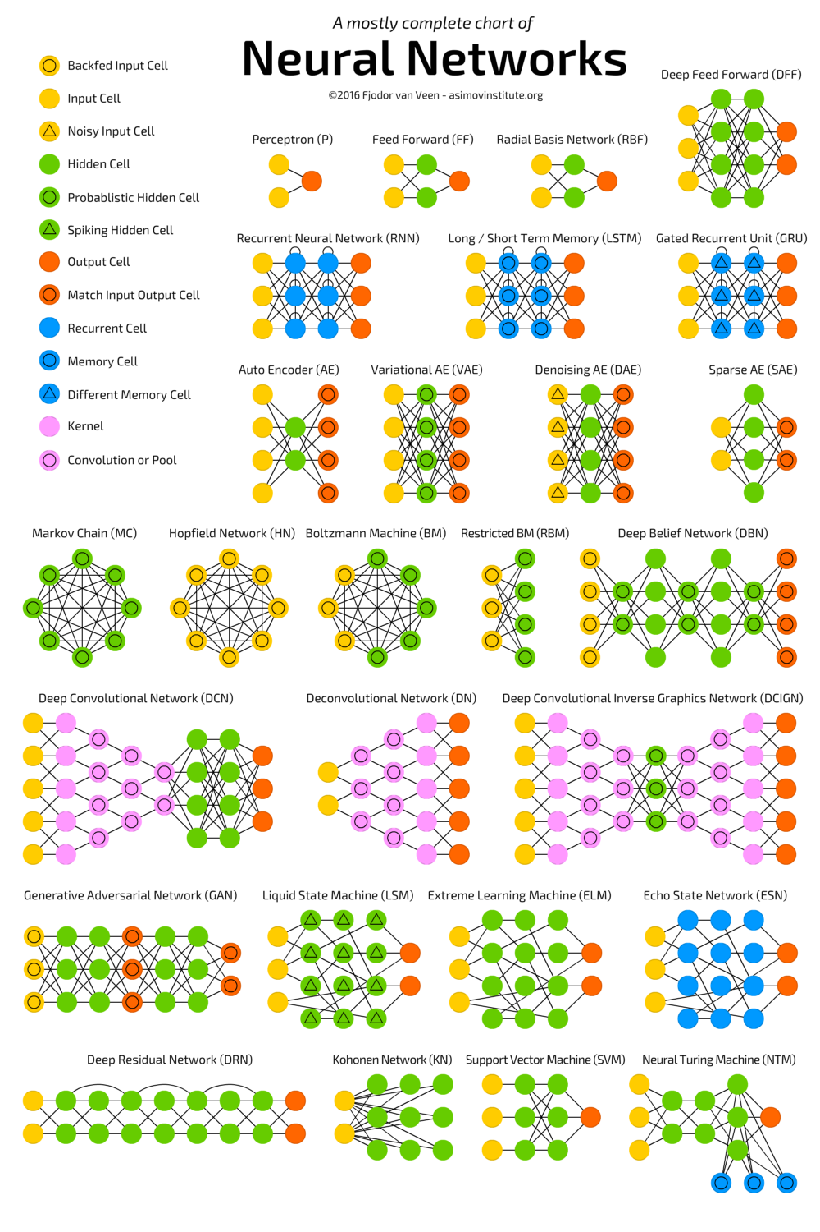
Neural Network Background:
Neural Networks are algorithms designed to recognize patterns.
Many different types of neural networks: Deep Feed Forward (DFF), Gated Recurrent Unit (GRU), Auto Encoder (AE)...
We chose to use a Recurrent Neural Network (RNN)
Derived from Feed Forward Neural Networks
Used mainly for speech recognition and handwriting recognition

Slide 5
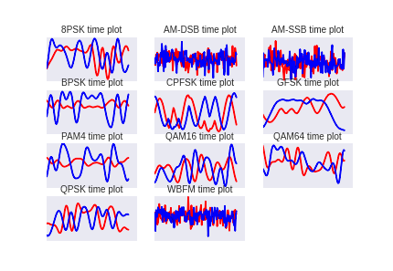
Dataset
Pulled from DEEPSIG DATASET: RADIOML 2016.10A
Generated with GNU Radio
Contains 220,000 radio frequencies
Consist of 11 modulation:
8 Digital: BPSK, QPSK, 8PSK, 16QAM, 64QAM, BFSK, CPFSK, and PAM4
3 Analog: WB-FM, AM-SSB, and AM-DSB

Slide 6
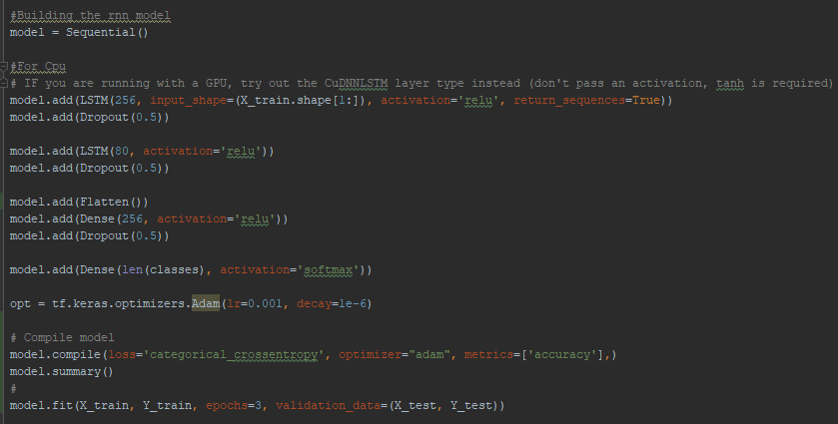
RNN Model

Slide 7
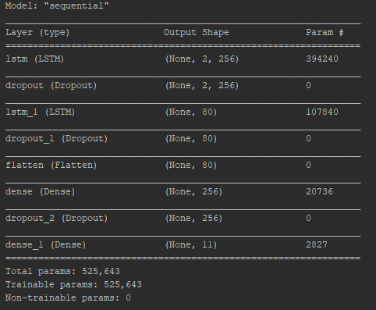
Model Summary

Slide 8
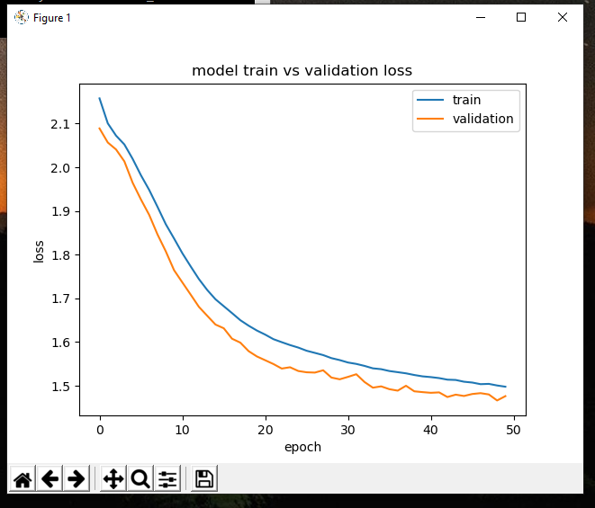
Results

Slide 9
Challenges this semester
Covid 19
Prevented meeting up for the rest of the semester.
Dividing the work among six people
The closure caused some work to be changed which made things harder to divide up.
Undertraining the RNN model
Improving the accuracy with the RNN model to get better results.
Notes:
This was not an issue we expected to come across. We were hit with the pandemic about midway through the semester. The issue was that we couldn’t meet, meaning we were not able to collect data. We had to use data from various sites, but I believe our results would have been better if we were able to collect our own data.
Due to closure of the campus parts of the project had to be scrapped due to the hardware being in two different locations. That meant there was less work for the team, especially the data team since we couldn’t capture the data ourselves. This was overcome with combining the teams and putting more effort into the machine learning aspect of the project.
Our group ran into some issues while running the RNN model. The biggest one was the low accuracy after training it. This took some research but was overcome by adding more iterations since we were undertraining it. The outcome was much better and more consistent to what we were looking for in terms of accuracy.

